Slide 1


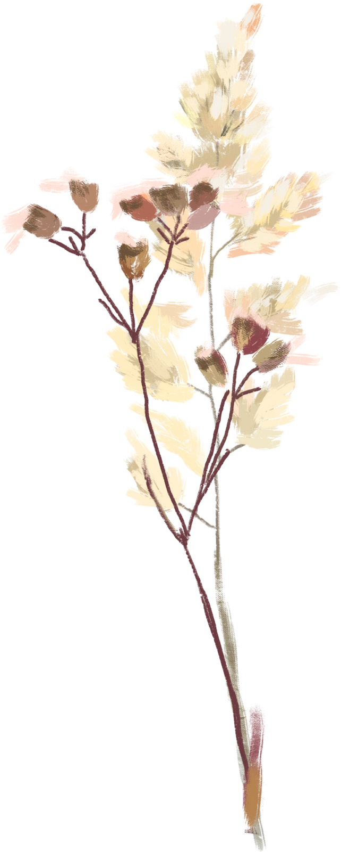
The Secret River
novel study

Slide 2
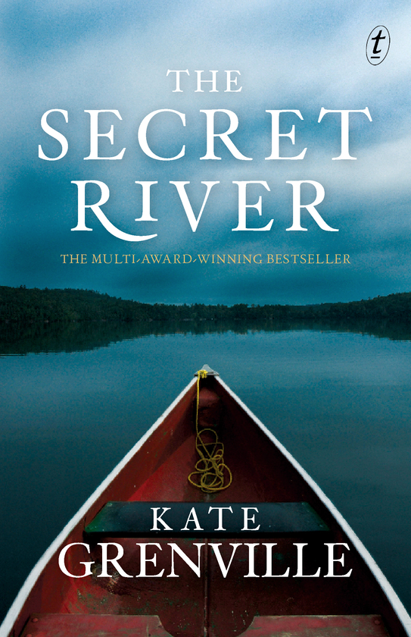
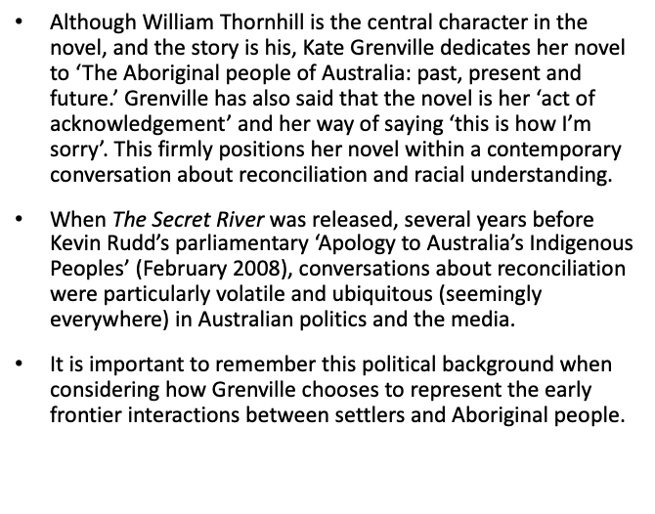
Apologies and acknowledgements

Slide 3
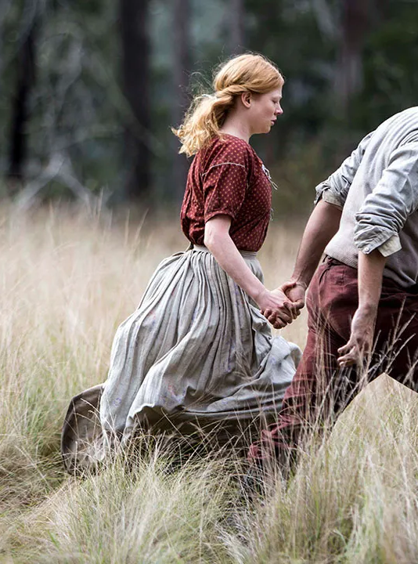
Genre
The Secret River is a historical novel. Historical fiction strives to present individuals' stories within the larger context of their social, cultural and political surroundings. A historical novel 'is not the re-telling of great historical events, but the poetic awakening of the people who figured in those events.
In The Secret River, the way this setting becomes accessible is through a sympathetic depiction of a character caught up in this historical narrative of settlement and conflict.
The Secret River has a traditional realistic style. Grenville aims to portray colonial life 'as it really was' for those who lived it.

Slide 4

Structure and Setting
The Structure of The Secret River is strictly chronological, with the exception of the prologue section.
The division of the novel into sections differentiated by location is a reminder of the importance of place in this text. When Thornhill is young he longs for a place of his own, and is envious of Sal's ability to belong in her family home on Swan Lane.
It is easy to understand why, in the poverty and overcrowding of London, it is important to the children to find a space in which they feel at home. For Thornhill, this longing continues well into adulthood. His need to own land and make a connection in NSW is always a driving motivation for him. Even the title of part five ('Drawing a Line') when read in this context, still refers to the Thornhill's connection with place. It describes his need to mark out his land and his space. Structurally, the novel is constantly reminding us of one of its themes: the importance of a sense of belonging.

Slide 5
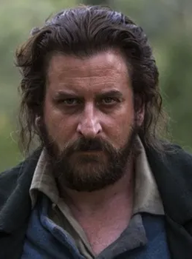
Aboriginal dialogue
It is important to note that Grenville chooses not to use any Aboriginal languages, as Thornhill is unable to understand it. For example, in his 'conversation' with Whisker Harry, Whisker Harry's words are 'as meaningless to Thornhill as the cry of a bird.'
Take note here of the way Aboriginal sounds and movement is often described in animalistic terms. This could be pertinent to a resistant reading.

Slide 6

STRANGERS
The title 'Strangers' describes Thornhill's relationship with an unnamed Aboriginal man; the broader relationship of the cultures each man represents, and Thornhill's relationship with the colonial landscape.
The central issue in this section is Thornhill's feeling of isolation and uncertainty in an unfamiliar country. He shouts at an Aboriginal man: "Be off!", which is motivated by:
his own instinct for self-protection, prompted b the thought of 'his skin punctured and blood spilled beneath these chilly stars.'
his desire to defend his family, 'those soft parcels of flesh: his wife and children.'
a courage inspired by both his anger and his new freedom after many months in the close confines of the convict transport.
These are his ongoing motivations throughout the text.
Q: Why does Grenville choose to present this particular scene as the prologue - how does it direct our reading of the entire novel?
Q: What do we learn from this section about William Thornhill's character, personality and values?

Slide 7
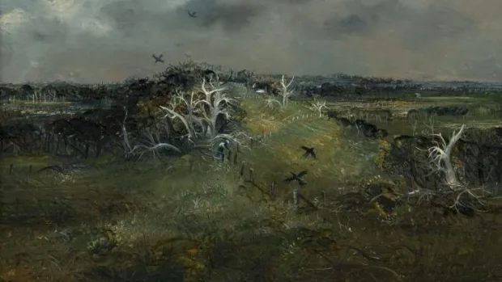

STRANGERS
Consider the depiction of Australia in the prologue. What evidence can you find that describes the landscape from Thornhill's perspective? What is the effect?
Evidence | Effect
Notes:
'fetched up at the end of the earth.'
'he could feel the night, huge and damp,'
'The air moved around him, full of rich dank smells. Trees stood tall over him.'
'A breeze shivered through the leaves, then died, and left only the vast fact of the forest.'
'He was nothing more than a flea on the side of some enormous quiet creature.'
'A scatter of stars as meaningless as spilt rice...only this blaze, unreadable, indifferent.'
'standing in the great sighing lung of this other place and feeling the dirt chill under his feet, he knew that life was gone.'
'He would die here under these alien stars, his bones rot in this cold earth.'
'The darkness is front of him whispered and shifted, but there was only the forest. It could hide a hundred black men with spears, a thousand, a whole continent full of men with spears and that grim line to their mouths.'

Slide 8
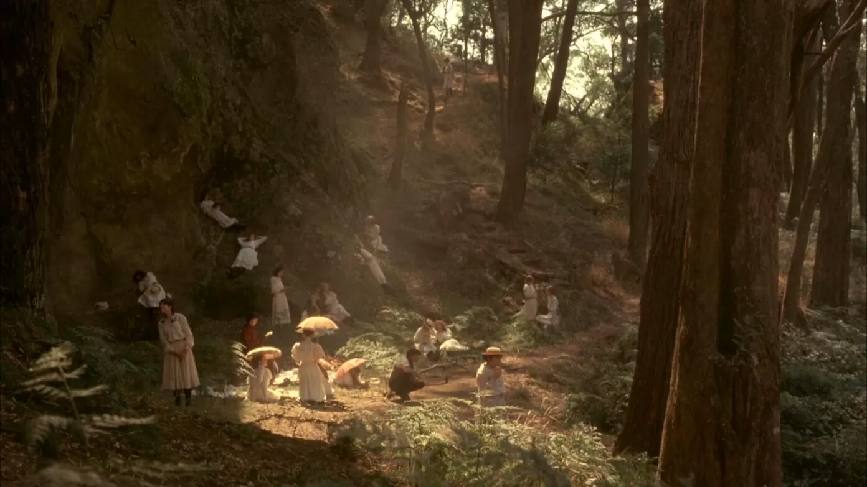
SYDNEY
Thornhill works for Thomas Blackwood on the river and inherits some of Blackwood's sympathy for the Aboriginal people, which is contrasted with Smasher Sullivan's attitude towards them: 'a pair of... hands cut at the wrist.'
On the Hawkesbury, Thornhill 'falls in love with a piece of ground.'
There are two conflicts in this section: a personal one between William and Sal, and a broader one between two contrasting race and cultures.
'Out on Sydney Cove puling an oar, Thornhill could imagine himself back on the Thames, but Sal could never for a moment stop seeing the differences between that place and this.'
Thornhill identifies 'two sorts of black natives.' The first is exemplified by Scabby Bill, an Aboriginal man who lives in the settlement and exchanges performances of his own cultural dance for alcohol from the settlers ('cheap white goods at the dreamtime sale', anyone?). This variety is perceived by the settlers to be 'relatively benign' if, 'a hazard of the place that had to be dealt with.'
The second variety is more frightening, partly for their invisibility to the settlers, as there are 'no signs that the blacks felt the place belonged to them' and yet 'sometimes men were speared' and killed.

Slide 9
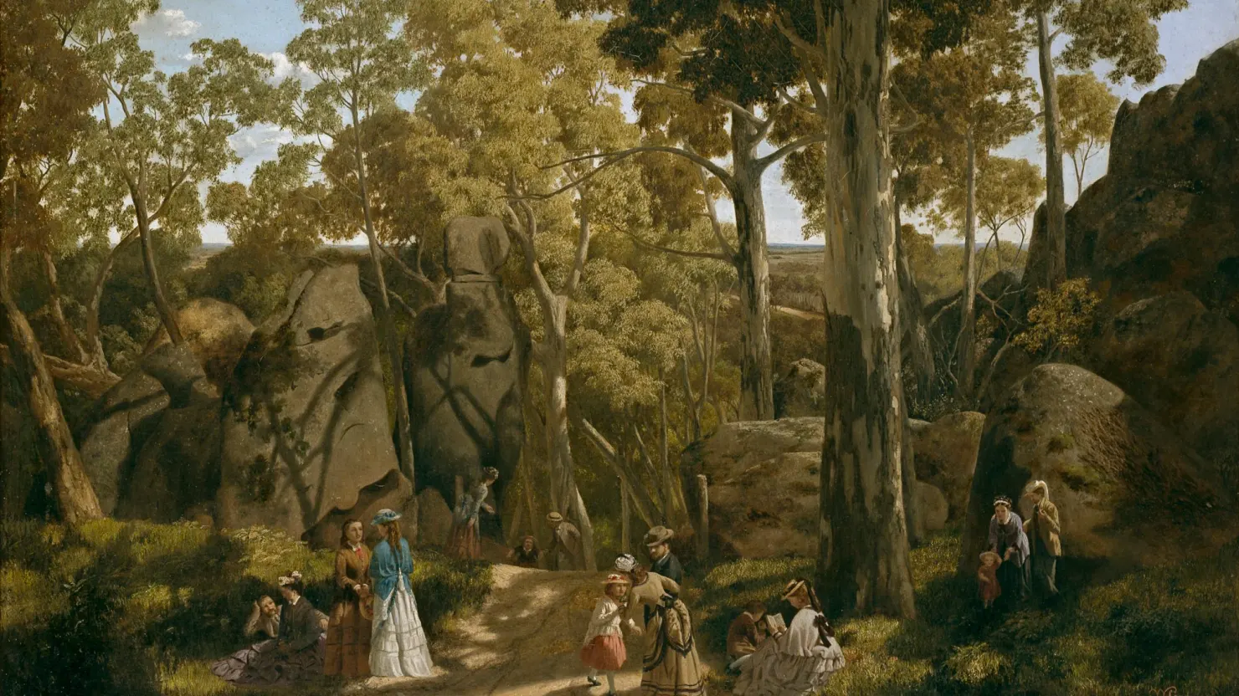
SYDNEY QUESTIONS TO CONSIDER
Q: How does William respond to Sal as his 'master', both literally (she is officially in charge of William while he is a convict) and figuratively (she takes charge in many situations, often marking decisions for William and the family)?
Q: Consider the quote 'no signs that the blacks felt the place belonged to them'. What does this suggest about colonial versus Indigenous perceptions of ownership? How does this foreshadow conflict in the novel, as well as reflect a source of conflict in Australia's colonial history?
Q: Does this conflict continue to exist in modern Australia?
Q: Does the juxtaposition of Blackwood and Smasher's characters serve a purpose?

Slide 10
FORMING A READING
Consider how we may view these chapters through a particular reading lens.
What is the dominant reading? What evidence could we consider?
Is there an alternate reading? What is it, and what evidence is relevant?
What is the resistant reading? What evidence could we consider?
In small groups, use the A3 paper to create jigsaws of three readings (divide the paper into 3 sections and write in each section).

